Slide 1
Manipulation of DNA- I

Slide 2

ENZYMES USED IN MOLECULAR BIOLOGY EXPERIMENTS

Slide 3
Nucleases

Slide 4
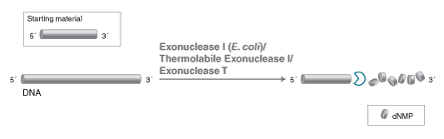
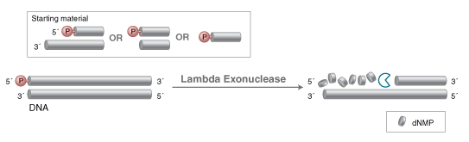
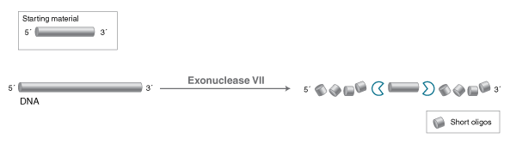
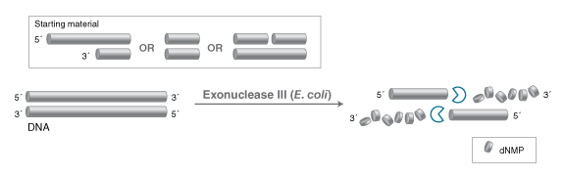
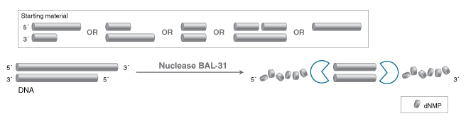
Exonuclease I
Lambda Exonuclease
Exonuclease VII
Exonuclease III
Nuclease Bal -31
Notes:
Micrococcal nuclease (MNase) exhibits exo- and endo-5'-phosphodiesterase activities against DNA and RNA. This enzyme digests double-stranded, single-stranded, circular and linear nucleic acids. The highest activity is toward single-stranded nucleic acid substrates with preference for AT- or AU-rich regions.

Slide 5
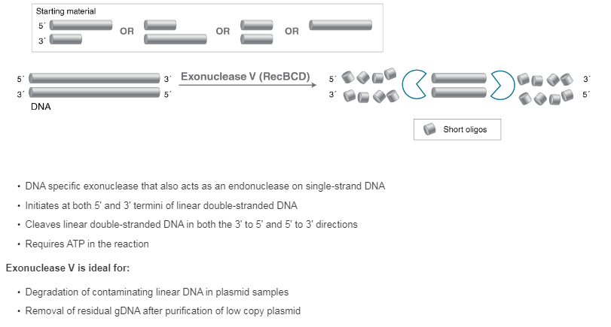

Slide 6
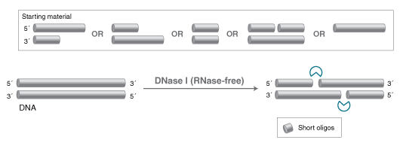
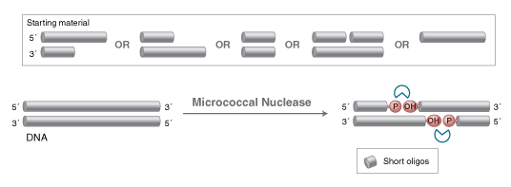
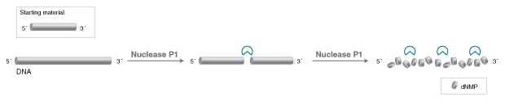
Dnase I
Micrococcal Nuclease I
P1 or S1 Nuclease I

Slide 7
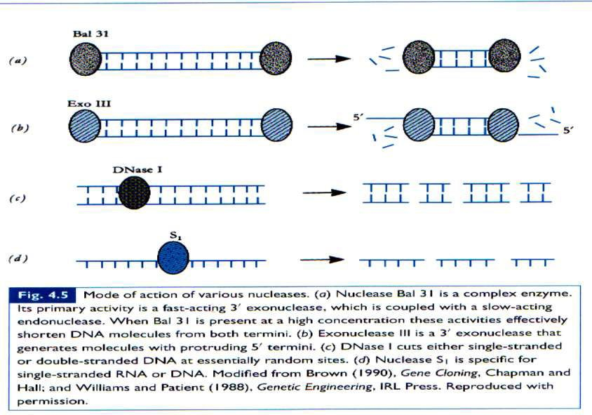
Nucleases
For a detailed list of exo and endonucleases refer
https://international.neb.com/tools-and-resources/selection-charts/properties-of-exonucleases-and-nonspecific-endonucleases
For their specific uses
https://international.neb.com/tools-and-resources/selection-charts/common-applications-for-exonucleases-and-endonucleases
Notes:
https://international.neb.com/tools-and-resources/selection-charts/common-applications-for-exonucleases-and-endonucleases

Slide 8
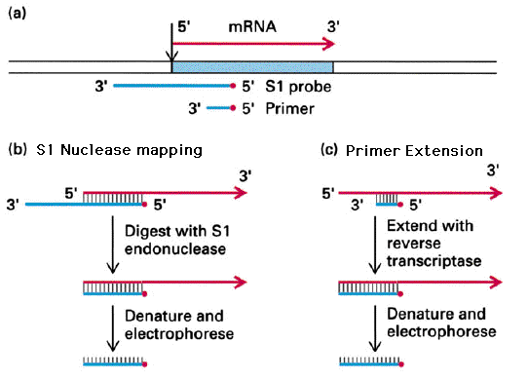
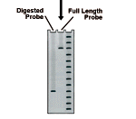
S1 Nuclease Use- Nuclease Protection Assay
Nuclease protection assays are used to map introns and 5' and 3' ends of transcribed gene regions.

Slide 9
RNAses
RNase A- obtained from bovine pancreas- RNase commonly used in research (cuts after C or U)
RNAse H- RNAse that cleaves the RNA in DNA/RNA hybrid
(uses- eg after cDNA synthesis)
Note- Reverse transcriptases lacking RNase H activity provide another option to prepare long cDNAs and libraries containing a high percentage of full-length cDNA.
RNase III-
Various classes- Some cleave precursors to make mature rRNA, snRNA or snoRNA. Also have examples like DROSHA , or DICER required for miRNA biogenesis
RNase T1- derived from Aspergillus oryzae (cleaves next to guanosine) in ssRNA
RNase R can degrade all linear RNAs
RNase P- ribozyme, a RNA that acts as a catalyst. Its function is to cleave off extra bases on tRNA molecules.
Notes:
Four Nobel prizes have been awarded for work associated with studies of RNase (Anfinsen, Moore, Stein, and Merrifield). With its importance in molecular science, four researchers have won Nobel Prizes for their work related to RNase A. The 1972 Nobel Prize in Chemistry was awarded to three researchers for their work with RNase A on the folding of chains in RNase A and the stability of RNase A. Christian Anfinsen received the 1972 Nobel Prize in Chemistry for his paper "Principles that govern the folding of protein chains." Stanford Moore and William H. Stein received the 1972 Nobel Prize in Chemistry for their paper "The chemical structures of pancreatic ribonuclease and deoxyribonuclease." The 1984 Nobel Prize in Chemistry was awarded to Robert Bruce Merrifield for his paper "Solid-phase synthesis" using RNase A.
Ribonuclease P is a ribonucleoprotein nuclease required for the site-specific cleavage of the 5′ leader sequence of precursor tRNAs. In eubacteria, the RNA subunit of RNase P is the catalytic moiety and is capable of processing precursor tRNA in the presence of divalent metal ions.¹ The single protein subunit of bacterial RNase P acts as a cofactor.^{2,3} In contrast, the RNA subunits of eukaryotic RNase P (human and yeast) do not exhibit enzymatic activity in vitro, an indication that their protein components are required for the catalytic reaction.

Slide 10
Restriction Endonucleases will be covered in the next class

Slide 11
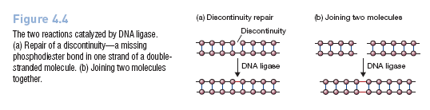
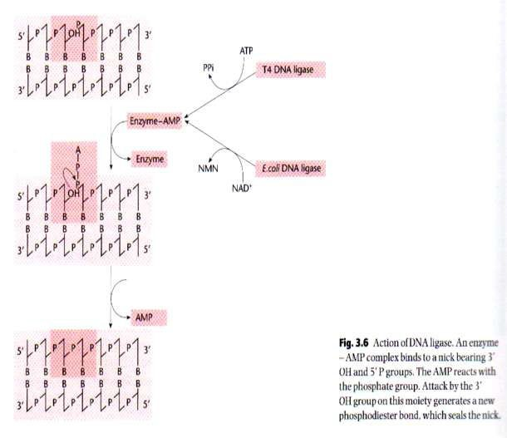
Ligases
It is an important cellular enzyme as its function is to repair the broken phosphodiester bonds that may occur at random or as consequence of DNA replication or recombination
Notes:
DNA ligase catalyzes the joining of the 3′-OH to the 5′-phosphate via a two step mechanism. First, the AMP nucleotide, which is attached to a lysine residue in the enzyme’s active site, is transfered to the 5′-phosphate. Then the AMP-phosphate bond is attacked by the 3′-OH, forming the covalent bond and releasing AMP. To allow the enzyme to carry out further reactions the AMP in the enzyme’s active site must be replenished by ATP.

Slide 12
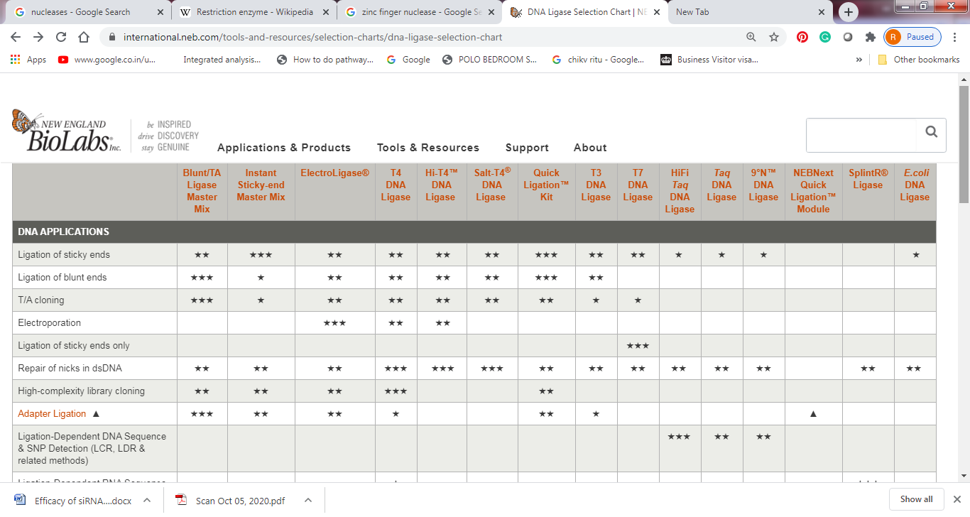
DNA LIGASE SELECTION CHART
Refer to DNA ligase selection Chart
https://international.neb.com/tools-and-resources/selection-charts/dna-ligase-selection-chart
Notes:
T4 DNA liagse and E.coli Ligase enzymes differ in two important properties. One is the source of energy:
T4 ligase uses ATP, while E. coli ligase uses NAD.
Another important difference is their ability to ligate blunt ends; under normal reaction conditions, only T4 DNA ligase will ligate blunt ends.

Slide 13
Ligation Temperature
Note- The DNA ligase enzyme has optimal activity at 25°C so the ligation reaction is carried out at a temperature that is a trade-off between the optimal temperatures for bringing the DNA ends together (1°C) and the enzymatic reaction (25°C). Normally 1hr at 16°C is fine but since bringing the DNA ends together is the least efficient part of the reaction favoring this by lowering the temperature to 8°C/4°C can give even more efficiency. However, the enzyme will work very slowly at this temperature so a long (e.g. overnight) incubation time is required.

Slide 14
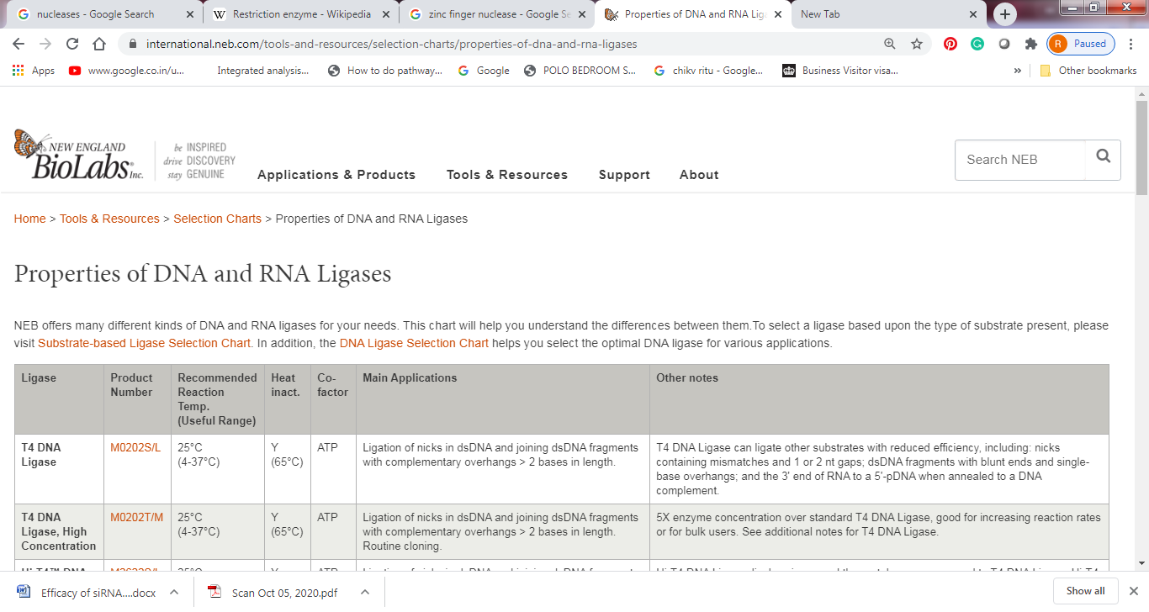
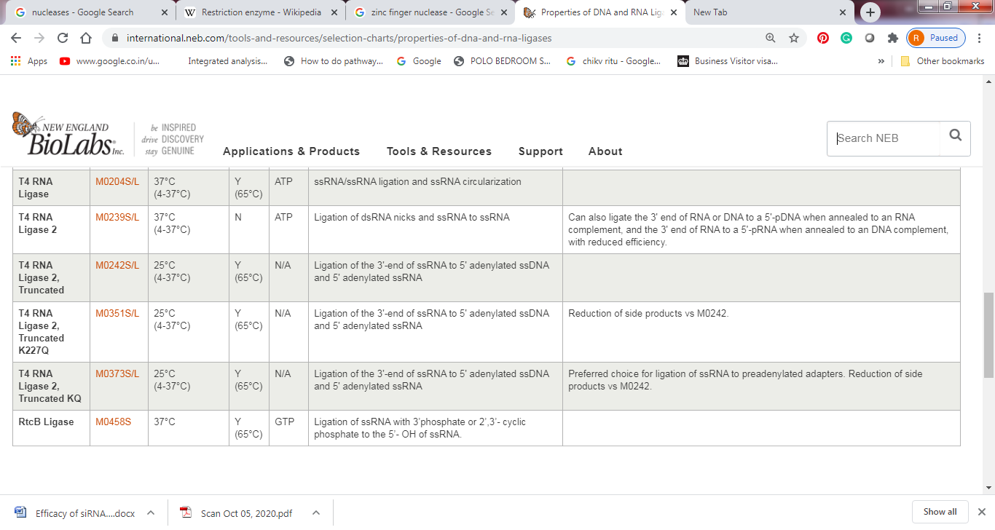
RNA LIGASE
T4 RNA Ligase 1 catalyzes the ligation of a 5´ phosphoryl-terminated nucleic acid donor to a 3´ hydroxyl-terminated nucleic acid acceptor through the formation of a 3´ → 5´ phosphodiester bond with hydrolysis of ATP to AMP and PPi. Substrates include single-stranded RNA and DNA as well as dinucleoside pyrophosphates.

Slide 15
Polymerases
When describing a polymerase enzyme, the terms DNA- dependent or RNA-dependent may be used to indicate the type of nucleic acid template that the enzyme uses.
DNA-dependent DNA polymerase copies DNA into DNA
RNA-dependant DNA polymerase copies RNA into DNA
DNA-dependant RNA polymerase transcribes DNA into RNA
Notes:
https://international.neb.com/tools-and-resources/selection-charts/dna-polymerase-selection-chart

Slide 16
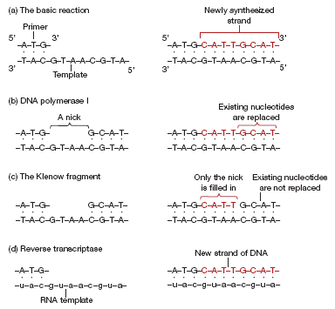
Notes:
The nuclease activity is contained in the first 323 amino acids of the polypeptide, so removal of this segment leaves a modified enzyme
that retains the polymerase function but is unable to degrade DNA- Klenow Fragment.

Slide 17
Klenow Fragment
The Klenow fragment is a large protein fragment produced when DNA polymerase I from E. coli is enzymatically cleaved by the protease subtilisin.
It retains the 5' → 3' polymerase activity and the 3’ → 5’ exonuclease activity for removal of preceding nucleotides and proofreading, but loses its 5' → 3' exonuclease activity.
Because the 5' → 3' exonuclease activity of DNA polymerase I from E. coli makes it unsuitable for many applications, the Klenow fragment, which lacks this activity, can be very useful in research. The Klenow fragment is extremely useful for research-based tasks such as:
Removal of 3’ overhangs or fill-in of 5’ overhangs to form blunt ends
Generates probes using random primers
Second strand cDNA synthesis

Slide 18
Exo-Klenow Fragment
Just as the 5' → 3' exonuclease activity of DNA polymerase I from E.coli can be undesirable, the 3' → 5' exonuclease activity of Klenow fragment can also be undesirable for certain applications. This problem can be overcome by introducing mutations in the gene that encodes Klenow. This results in forms of the enzyme being expressed that retain 5' → 3' polymerase activity, but lack any exonuclease activity (5' → 3' or 3' → 5'). This form of the enzyme is called the exo- Klenow fragment.
The exo-Klenow fragment is used in some fluorescent labeling reactions for microarray, random primer labeling, DNA sequencing by the dideoxy method.
Note-This enzyme will leave a single-base 3´ overhang on a significant proportion of DNA fragments during fill-in of 5´-overhangs. Therefore, Klenow Fragment, Exonuclease Minus, is not recommended for preparation of blunt-ended fragments for ligation

Slide 19
T4 DNA Polymerase
T4 DNA Polymerase catalyzes the synthesis of DNA in the 5´→ 3´ direction and requires the presence of template and primer. This enzyme has a 3´→ 5´ exonuclease activity which is much more active than that found in DNA Polymerase I (E. coli). Unlike E. coli DNA Polymerase I, T4 DNA Polymerase does not have a 5´→ 3´ exonuclease function. Highlights
Extreme fidelity
Gap filling (no strand displacement activity)
Best enzyme for creating blunt ends
Isolated from a recombinant source
Product Source
Purified from a strain of E. coli that carries the T4 DNA Polymerase gene.
Applications
3´ overhang removal to form blunt ends
5´ overhang fill-in to form blunt ends
Second strand synthesis in site-directed mutagenesis
Probe labeling using replacement synthesis

Slide 20
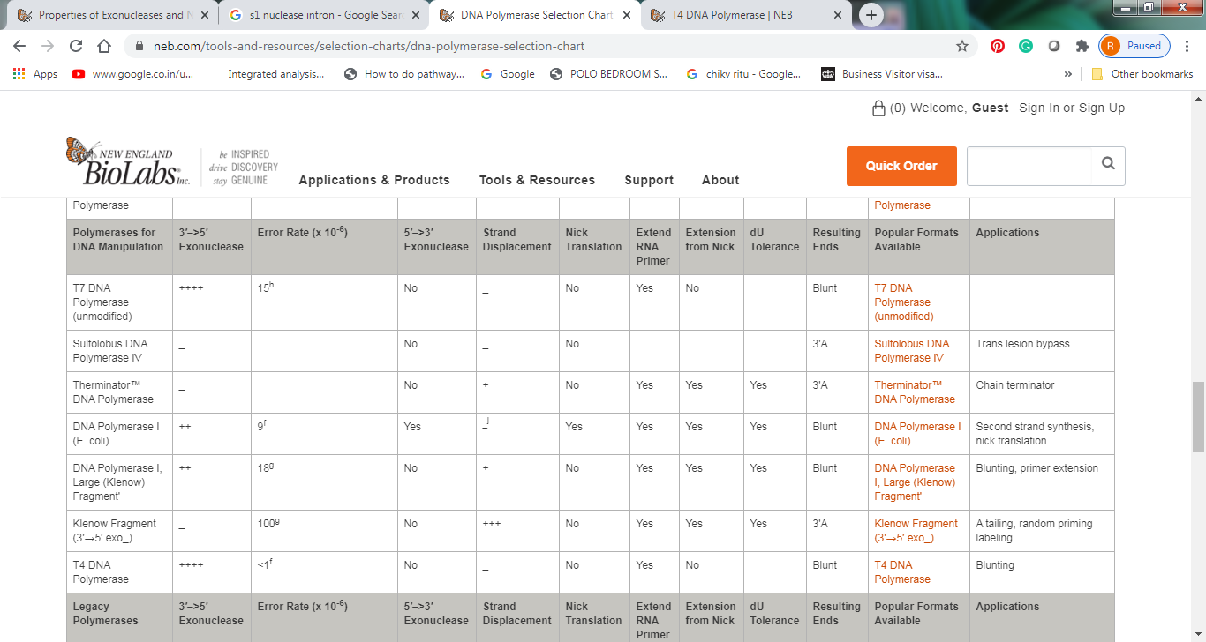
Polymerase comparison Chart

Slide 21
Taq DNA polymerase
Taq polymerase is a thermostable DNA polymerase I named after the thermophilic bacterium ... Taq makes DNA products that have A (adenine) overhangs at their 3' ends.
Notes:
Actually the terminal transferase activity of various DNA polymerases are governed by various conditions. Like the addition of the terminal nucleotide can be terminal specific. In the case of enzyme Sequenase, the polymerase most frequently incorporates an additional nucleotide that is the same as the 3' terminal nucleotide directed by the template. But in the case of Vent or Taq DNA polymerase, dATP is preferred in all terminals, which is probably a manifestation of the enzyme's high affinity for dATP.

Slide 22
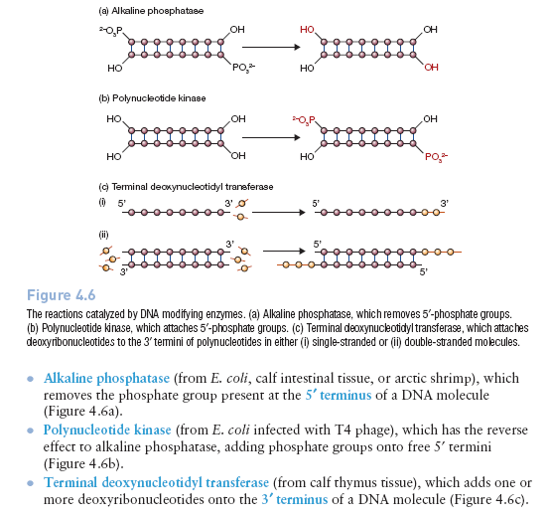
DNA MODIFYING ENZYMES

Slide 23
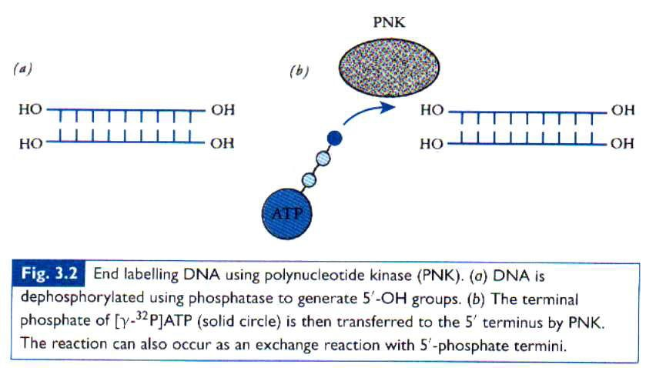
Polynucleotide Kinase

Slide 24
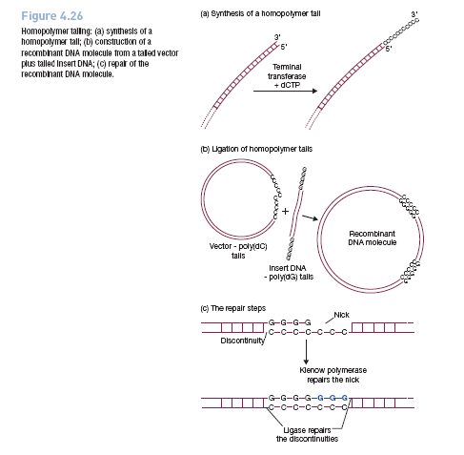
Terminal Transferase

